Slide 1
MYBANK APPLICATION
Medhini Shetty

Slide 2
MODULE: CARDS
IntRoduction
Database Design
Data flow
Architecture Diagram
Overview

Slide 3

INTRUDUCTION
The MyBank project is a comprehensive banking system that manages various aspects of banking operations. It consists of several modules, each designed to handle specific banking services
Card module: These modules create and manages the debit Card of the customer
These module include debit card number, debit card cvv, type, debit card status.

Slide 4
Overview
Soap: List all cards
Rest :Divided into 3 parts
1)Activate
2)Update
3)Block

Slide 5
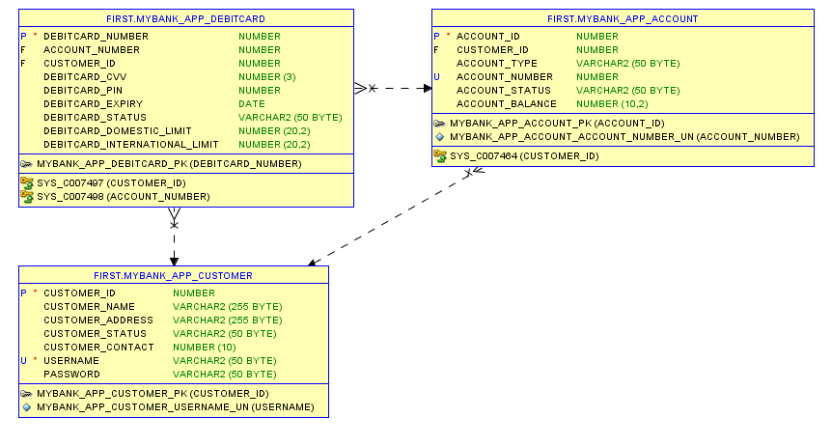
Data Base Design

Slide 6
Data flow diagram
start
Login
Dashboard menu
View cards
Activate card
Card activated successfully status
stop

Slide 7
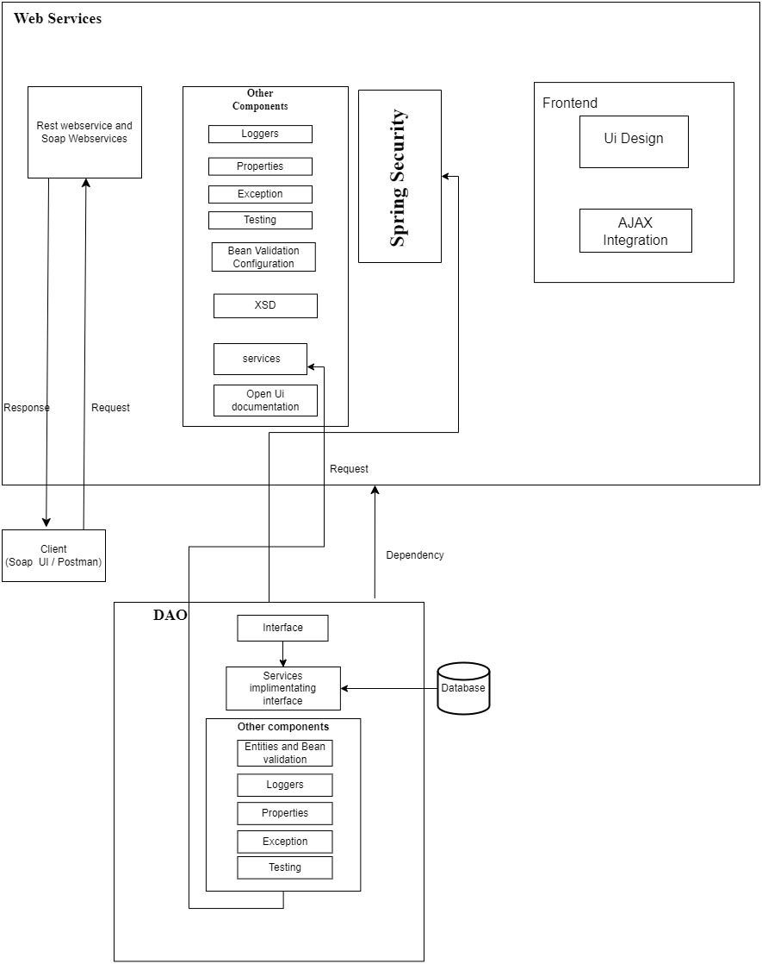
Architecture Diagram

Slide 8
JAR FILE LINK
C:\Users\xxshetvm\Desktop\DLTE-JavaFullStack-MEDHINISHETTY-2024\DLTE-FinalProject\mybank-debitcard-dao\target\mybank-debitcard-dao-0.0.1-SNAPSHOT.jar
C:\Users\xxshetvm\Desktop\DLTE-JavaFullStack-MEDHINISHETTY-2024\DLTE-FinalProject\mybank-debitcard-web\target\mybank-debitcard-web-0.0.1-SNAPSHOT.war

Slide 9

GIT HUB LINK
https://github.com/medhinishetty6/DLTE-JavaFullStack-MEDHINI-SHETTY-2024/tree/master/DLTE-FinalProject

Slide 10
THANK YOU

